Slide 1

Tree Decompositions Prepared By : 1705087
01

Slide 2
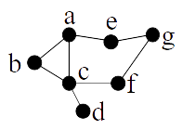


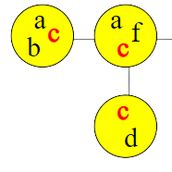
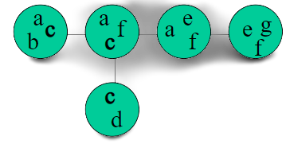
Tree Decomposition
Tree with a vertex set called bag associated
with the every node
For all edges {v,w} :
There is a set containing both v and w.
For every v : the node that contain v
form a connected subtree.

Slide 3
Tree Decomposition
Formally, a tree decomposition of graph G = (V, E) consists of a tree T and a subset Vt ⊆ V associated with each node t ∈ T. We call the subsets Vt bags of the tree decomposition. The tree T and {Vt | t ∈ T} must satisfy:
• (Node coverage) Every node v belongs to at least one bag Vt .
• (Edge coverage) For every edge e, there is some bag Vt containing both ends of e.
• (Coherence) Let t1, t2 and t3 be three nodes of T such that t2 lies on the path from t1 to t3. Then, if a node v of G belongs to both Vt1 and Vt3 , it also belongs to Vt2

Slide 4
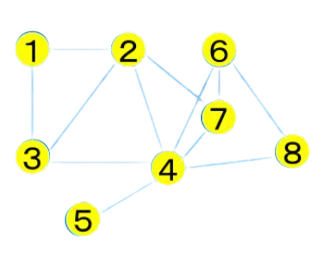

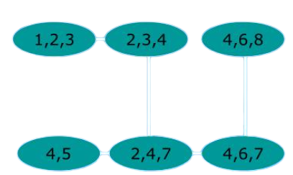


Example
Property
1
2
3

Slide 5

Tree-Width of Graph
The tree-width of an undirected graph is an integer number which specifies how far the graph is from being a tree.
Tree-Width captures how similar a graph is to a tree
Tree-width is a useful tool to solve graph problems for several special instances, both for theory and for practice

Slide 6
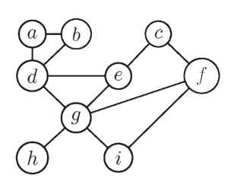


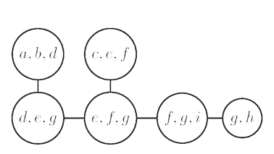

Tree Width
The width of tree decomposition of (T, Vt)
of a graph G is defined to be :
max{|Vt|− 1: t ∈ T}
The tree-width of a graph G, denoted by tw(G),
is the minimum possible width of
a tree decomposition of G.
Max |Vt| =
tw =
Bag Sizes

Slide 7

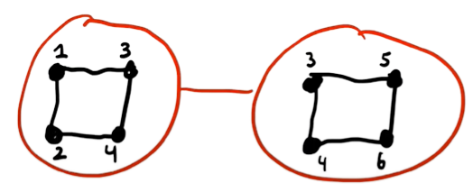
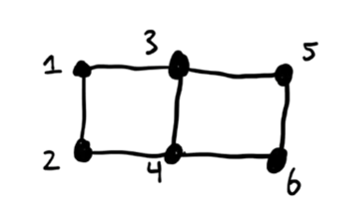

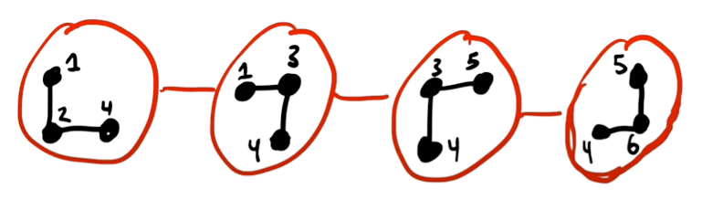
Example
tw =
tw =

Slide 8
Why do we need to compute Tree-Width?
1
2
Analysis of Graph Algo Due to the roles the tree-width plays in an enormous number of fields, different practical and theoretical algorithms computing the tree-width of a graph were developed.
Approximation / Bounding Depending on the application on hand, one can prefer better approximation ratio, or better dependence in the running time from the size of the input or the tree-width..

Slide 9
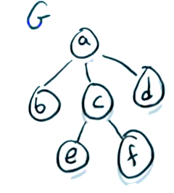
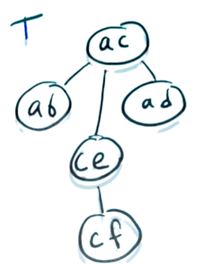
Tree-Width Facts
Forests and trees are of treewidth at most 1
The treewidth of an outerplanar graph is at most 2
series–parallel graph has treewidth at most 2
The treewidth of a t × t grid is t
The treewidth of an n-vertex clique Kn is n − 1
Treewidth of complete bipartite graph Kn,m is min{m, n} − 1

Slide 10
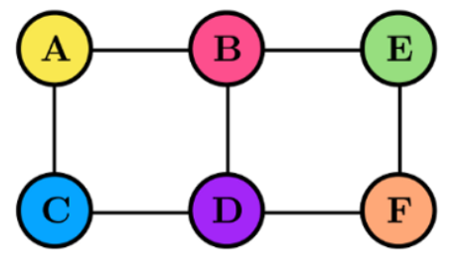


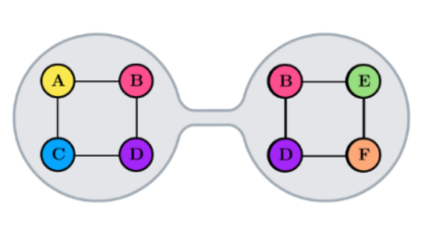
Lemma 7.3 :
Let (T, t∈V (T)) be a tree decomposition of a graph G and let ab be an edge of T. The forest T − ab obtained from T by deleting edge ab consists of two connected components Ta (containing a) and Tb (containing b).
Let A = S t∈V (Ta) and B = S t∈V (Tb) . Then (A, B) is a separation of G with separator Xa ∩ Xb.
Ta
Tb
a
b

Slide 11
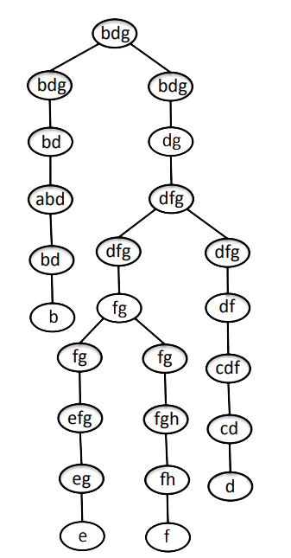
Nice Tree Decompositions
A nice tree decomposition is a rooted binary tree with four different types of nodes:
Leaf nodes have no children and bag size 1.
Introduce nodes have one child. The child has the same vertices as the parent with one deleted.
Forget nodes have one child. The child has the same vertices as the parent with one added.
Join nodes have two children, both identical to the parent.

Slide 12
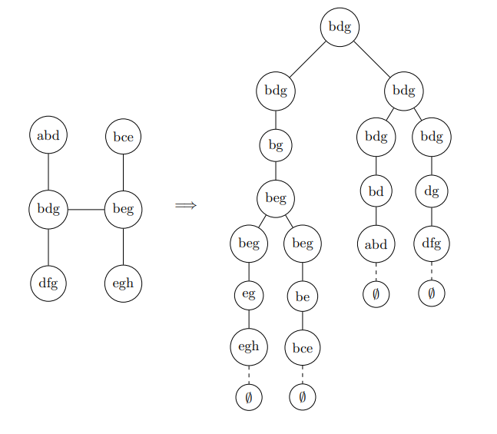
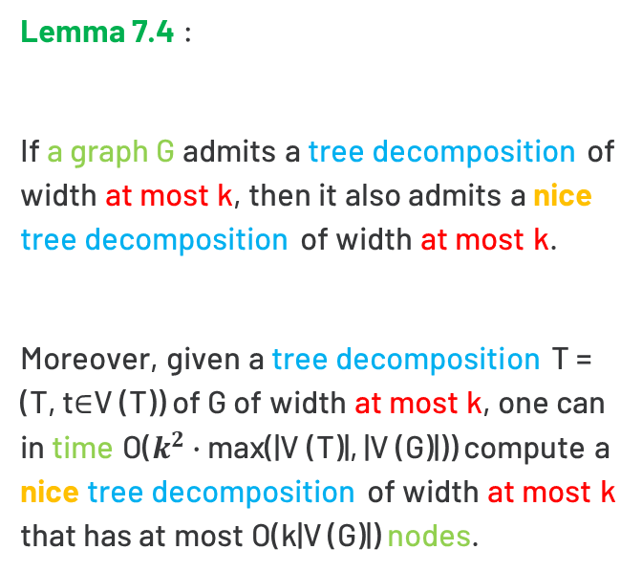
Lemma 7.4 :
If a graph G admits a tree decomposition of width at most k, then it also admits a nice tree decomposition of width at most k.
Moreover, given a tree decomposition T = (T, t∈V (T)) of G of width at most k, one can in time O($k^{2}$ · max(|V (T)|, |V (G)|)) compute a nice tree decomposition of width at most k that has at most O(k|V (G)|) nodes.

Slide 13
Applications [Tree-Composion]
Many NP hard problems are liner time solvable in Tree .
Solving problem with Dynamic Programming
(ig. Graph color , Hamiltonian Cycle so on )
Probabilistic Networks , Graph minors .

Slide 14
Thank you!
I’m so grateful for your patience

